Slide 1
Introduction to Capgemini
July 2017

Slide 2
Group Overview

Slide 3


Capgemini Group: Who we are
One of the world's foremost providers of consulting, technology and outsourcing services with presence in over 40 countries.
Listed on Paris Stock exchange since 1985.
For the third consecutive year, we were named “One of the World’s Most Ethical Companies®” by the Ethisphere Institute.
Our Vision: the business value of technology comes from and through people.
Helping our clients improve their performance and competitive positioning through a people-centered approach to technology.

Slide 4



From purpose ... to creating impact
OUR VISION
OUR MISSION
The business value of technology comes
from and through people
With you, we create and deliver business and technology solutions that fit your needs and drive the results you want
4
© 2017 Capgemini. All rights reserved.

Slide 5










From a 50 years track record …
as an independent company
1967
SoGETI founded by Serge Kampf in Grenoble, France
on October 1
1968
Gemini Computer Systems Inc. based in New York
1973
Sogeti, Gemini Computer Systems and CAP merged as
1975
First Annual Report published
1978
Cap Gemini Inc. established in Washington DC
1985
Cap Gemini Sogeti listed on the "Second Market" of the Paris Stock Exchange
1991
Creation of
Consulting resulting from the merger of five management consulting firms
1993
First transformation program of the Group’s organization, sales approach, methods and culture, called “Genesis”
1996
The Group reorganized its shareholding and management structure and adopts a new name and a new logo:
1998
Cap Gemini is included on the CAC 40 listing on the Bourse
1999
Cap Gemini is voted "European Company of the Year" by the European Press Federation
2000
Acquisition and merger with Ernst & Young Consulting to form
2002
Name revived to offer Local Professional Services
The Board of Directors name Paul Hermelin, CEO
Opening of an international training and conference center in France at Les Fontaines
2004
Name and logo changed to
coinciding with global ad campaign to position “The Collaborative Business ExperienceTM”
2007
Capgemini acquires Kanbay and Indigo, expanding its offshore capabilities in India
2009
Consulting Services becomes a global entity:
2010
Acquisition of CPM Braxis in Brazil
2011
Eight acquisitions, including Prosodie, leader in front office transaction solutions
2012
Paul Hermelin is appointed Chairman & CEO
2013
At 24th Rencontres in San Francisco, prominent industry leaders and partners acknowledged Capgemini as a Global Leader in its market.
Capgemini has been named by the Ethisphere Institute’s as one of the World’s Most Ethical Companies for 2013 (for the first time)
2014
Acquisition of Euriware
2015
Acquisition of IGATE
2016
March 15: Founder Serge Kampf passes away at the age of 81
5
www.capgemini.com/about/group/history
© 2017 Capgemini. All rights reserved.

Slide 6

2016 Performance
Revenue
€12,539
million
Operating Margin
€1,440
million
Operating Profit
€1,148
million
Energy, Utilities & Chemicals
Revenue by Business
Revenue by Industry
Financial Services
Application Services
Public Sector
Other Managed Services
Others
Technology and
Engineering Services
Manufacturing, Automotive
& Life Sciences
Consulting Services
Telecom, Media & Entertainment
Consumer Product, Retail, Distribution
& Transportation
6
© 2017 Capgemini. All rights reserved.

Slide 7
A Proven Track Record of Growth
Financial Services is Capgemini’s largest sector, representing 26% of overall Capgemini 2016 revenue
Capgemini Revenue from FS (€Bn)
At a Glance
55,000+ | Professionals in a global network serving financial services clients
37,000+ | Professionals in India dedicated to financial services
25⁺ | Years delivering offshore services to banks and insurers
Consistent Growth

Slide 8
40+ countries and 120+ nationalities (As of December 31, 2015)
FOR INFORMATION:
Argentina
Australia
Austria
Belgium
Brazil
Canada
Chile (Production center only)
China / Hong Kong
Colombia
Czech Republic
Denmark
Finland
France
Germany
Guatemala (Production center only)
Hungary
India
Ireland
Italy
Japan
Luxemburg
Malaysia
Mexico
Morocco (Production center only)
New Zealand
Norway
Philippines
Poland
Portugal
Romania
Saudi Arabia
Singapore
Slovakia
South Africa
Spain
Sweden
Switzerland
Russia (Production center only)
Taiwan
The Netherlands
UK
United Arab Emirates
US
Vietnam (Production center only)
+ 180,000
people worldwide
(98 430 working offshore)
Europe
62 301
North
America
16 034
Asia-Pacific
Middle-East & Africa
91 504
Latin America
9 363
1 407
Officially we say:
More than 180,000 people
in over 40 countries
(As of December 31

Slide 9







We are a multicultural people company
190,000+ people worldwide
working together as one team
North America
Middle-East
~16,780
~95
Latin America
Asia-Pacific
~8,580
~5,060
Europe
India
~64,400
~96,680
9
© 2017 Capgemini. All rights reserved.

Slide 10


Our Brand promise
“It is the quality of our people, and their capacity to deliver fitting solutions, with you and for you, that drive real business results.”

Slide 11
Capgemini Values: At the heart of everything we do
A formalized set of shared values guide our business decisions and shape our culture. The practical expression of these values and objectives can be seen in the collaborative relationships we build, the standards by which we measure our work, and the commitments we make to our people.
1
2
3
4
5
6
7
Honesty
Boldness
Trust
Freedom
Team Spirit
Modesty
Fun
define who we are
Capgemini’s seven values have been established through experience
They
are the foundation of our future
define how we behave
are the product of our history

Slide 12
Systems and Tools
Systems & Tools

Slide 13
Log-in & Security: Password Details
Systems & Tools
Getting Started
Log-in / Safeword
Getting user ID and Password
Once you get your employee ID from people process team, you need to call up ITICS service desk for your user ID
and Password. Make sure you change your password at the first logon.
Password Policy
Note that your password MUST respect the following mandatory rules
MUST have at least 8 characters
MUST use characters from three of the following four categories:
Uppercase characters (A through Z)
Lowercase characters (a through z)
Number (0 through 9)
Non-alphanumeric characters (!, $, #, %)
Must be changed every 60 days.
Do NOT use common or proper nouns.
Do NOT use your name or login name, even with digits.
You CANNOT reuse one of your last 5 passwords.
You CANNOT change a password which has been changed less than 1 day ago.
In order to change your domain password, your machine needs to be connected to the Capgemini network physically or connected using
VPN. This ensures the password change you just made, synchronizes to the network and both your laptop and the network now use the
same password.
Notes:
Key Points:
Our passwords are very complicated and can be difficult to remember (for good reason) → client confidentiality
Passwords should be changed every 3 to 6 months

Slide 14
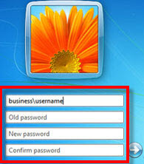

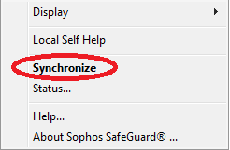
Log-in & Security: How to change Password
Systems & Tools
Getting Started
Log-in / Safeword
Within Office
Login to desktop / laptop
Press Ctrl+Alt+Del
Click Change Password button and follow instructions
For Laptop users, once password is changed, right click Sophos Safeguard
Shield in the Notification area
Click Synchronize
Outside Office (Laptop Users)
Login to laptop
Connect Capgemini VPN, using Cisco Any Connect VPN
Press Ctrl+Alt+Del
Click Change Password button and follow instructions
For Laptop users, once password is changed, right click Sophos
Safeguard Shield in the Notification area
Click Synchronize
Notes:
Key Points:
Keep exercise within the time limit
Ensure everyone participates
Explain the “remote on VPN” instructions and clarify it is for out of office use

Slide 15
Desktop / Laptop / Telephone Extension Allocation
Desktop Allocation
ICRES Space Allocation Team will allocate a desk and Log a ticket with ITICS for Desktop Allocation.
ITICS Asset Team will verify and allocate a desktop.
Ensure that new desktop allocation requests should be routed through GFM Space Allocation Team
Laptop Allocation
Associates designated Managers and Above will get a laptop as a part of joining
The laptop allocation ticket for Sr. Managers and above will be logged by people process team.
The laptop allocation ticket for Managers will be logged by respective project team.
Telephone Extension Allocation
Once the desk is allocated to you, you need to log a ticket with ITICS to get telephone extension
While logging ticket for telephone extension, provide details such as your desk location, telephone instrument set type, project name.
Note: Every individual will have a responsibility to safeguard Capgemini ITICS Assets allocated to him / her. Any damages to it will be charged back to the Project / individual.

Slide 16
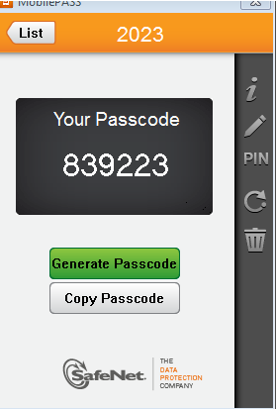
Log-in & Security: Mobile Pass
Systems & Tools
Getting Started
Log-in / Safeword
To login to Capgemini resources remotely, you need to use a password generated on Mobile Pass. You will receive Mobile Pass with your new laptop.
The purpose of using a Mobile Pass is for enhanced login security.
The Mobile Pass authentication process consists of two parts – the first part is a number memorized by the user & the second part is the password displayed on the Mobile Pass.(This number lasts on the display for 60 seconds).
Notes:
Key Points:
Explain that this is for out of office use

Slide 17
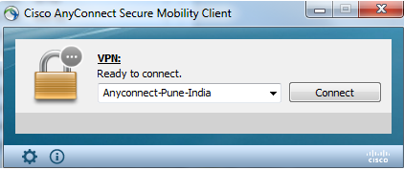
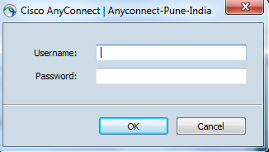

Log-in & Security: VPN
Systems & Tools
Getting Started
Log-in / Safeword
From your Laptop select Start=>All Programs=>Cisco=>Cisco AnyConnect Secure Mobility Client when you are connected through Broadband or cable internet. From the drop down select the desired profile and click Connect
Enter your User ID in the Username field.
Enter the 6 digit number displayed on the Mobile Pass, in the password field and click OK
The VPN Client will minimize into a tiny locked padlock indicating you are connect to the VPN.
Notes:
Key Points:
You need to do this for Outlook and access to the intranet when out of the office

Slide 18
Key Communication Tools
Systems & Tools
Getting Started
E-mail
Email Client: Microsoft Outlook is the Capgemini email client. The mailbox size is provided as per the designation. You will need to manage this space and create archives in Outlook as needed to save older mail items.
Lync/Skype: Lync or Skype , is the Capgemini version of Microsoft Office Communicator. We use this tool to communicate with our Capgemini colleagues or clients around the world.
Live Meeting / Lync Meeting: You can plan a Live Meeting / Lync Meeting via your Outlook calendar. In a meeting request, there will be an active link to a chat session. To plan a meeting when not connected via VPN, you can use Web GIMS, a web-based version of this tool.
Transfer Large Files: If you want to transfer large files, then access the FTP site https://fts.capgemini.com
Notes:
Key Points:
Clean / archive frequently
You will not be ale to send / receive email once limited is reached

Slide 19
Ways to Contact IT Team
In order of preference:
1. Log a ticket with online Service Desk Portal
http://support.capgemini.com
2. If you are unable to raise a ticket through Service Desk Portal, you can send email to Service Desk email ID
Outlook Display Name: IN, ITICS Service Desk
Email Address: iticsservicedesk.in@capgemini.com
3. If you are unable to access tool or email and the request / incident is urgent you can reach us below mentioned extensions
Location | Within Office | Outside Office
Chennai | 4004 | +91 44 69444004
Pune |  | +91 20 69444004
Gurgaon |  | +91 11 69444004
Hyderabad |  | +91 40 69444004
Bangalore |  | +91 80 69444004
Kolkata |  | +91 33 69444004
Mumbai |  | +91 22 69444004

Slide 20

Email: Outlook
Systems & Tools
Getting Started
E-mail
Microsoft Outlook is the Capgemini email client
Your Outlook is setup to maintain a cached copy of your mailbox. This allows you work in Outlook while being offline.
All your email, contacts, calendar items, and tasks will be viewable up to the last time you synced. New emails will be received or sent the next time you connect to the network or VPN.
The mailbox size provided is 250mb. You will need to manage this space and create archives in Outlook as needed to save older mail items.
The maximum message size per email is 5mb. To send larger files use the FTS site (http://fts.capgemini.com), then send the link for the file(s) to your recipient.
For Outlook support, please raise a ticket on the FS SBU Service Desk portal (http://support.capgemini.com)
Notes:
Key Points:
Clean / archive frequently
You will not be ale to send / receive email once limited is reached

Slide 21

Email Signature
Systems & Tools
Getting Started
E-mail
Your email signature must contain the following information:
The signature (Your details, the CBE Label and the Group slogan)
The email disclaimer (automatic on outbound emails)
The Green logo (optional)
How to set up your signature
Step 1: Download the Email signature template and save it on your desktop.
Step 2: Open the “Email signature set up” document (Must read) which will guide you, step by step, during the installation procedure.
Step 3:
Customize your signature
Ensure correct placement of
Financial Services Global Business Unit.

Slide 22
File Storage & Transfer: File Transfer Service (FTS)
Systems & Tools
Getting Started
E-mail
File Transfer Service is designed to send large files (1 GB max) to your company's colleagues or to your external customers
It also makes possible for the company's users to get larges files from an external customer by generating a temporary directory that enable him to upload documents you can download afterwards
FTS site: http://fts.capgemini.com
Directions: Upload files to the server then use the link provided to retrieve the files.

Slide 23
Help Desks
STD CODES ACROSS LOCATIONS
PUNE | 20
HYDERABAD | 40
CHENNAI | 44
GURGAON | 11
KOLKOTTA | 33
BANGALORE | 80
MUMBAI | 22
Human Resources – 2011500
Information Technology – 4004
ICRES- 2013500
Payroll – 2011900
Time – 2011625
IT helpdesk operates 24/7; other from 8:30am to 6:00pm
Raise a ticket on FS Service Desk Portal:
iConnect> Facilities > Capgemini FSSBU Helpdesk

Slide 24
FS SBU Tools can be found on iConnect
Systems & Tools
Capgemini Toolset
iConnect
Capgemini Systems and Tools
iConnect
Finance
Facility
Delivery
Employee
Management
Notes:
Key Points:
We will now get familiar with some of the standard tools used internally

Slide 25
iConnect
Systems & Tools
Capgemini Toolset
iConnect
iConnect is the single entry point for all FS SBU Applications
The features provided allow employees to view and update their HR records
The application reduces the administrative workload by simplifying processes to get your personal information updated in the system
To log onto iConnect, please visit https://iconnect.fs.capgemini.com
You will be redirected to the SSO authentication page.
Use your CORP ID and password to login onto the site

Slide 26
Useful Links on iConnect
Systems & Tools
Capgemini Toolset
iConnect
Other Useful links
Expense Tool (Expense Reimbursement Tool)
Clarity ( Time Entry Tool)
My path (Talent Management Tool)
TRS (Telephone Reporting System - for classifying your calls)
Web GIMS Number
Stationary/Business Card
Bus Pass( For HYD & PUNE )
Capgemini FS-SBU Knowledge Management portal. (KM 3.0)
RMG Portal (Recruitment Mobility Group)

Slide 27
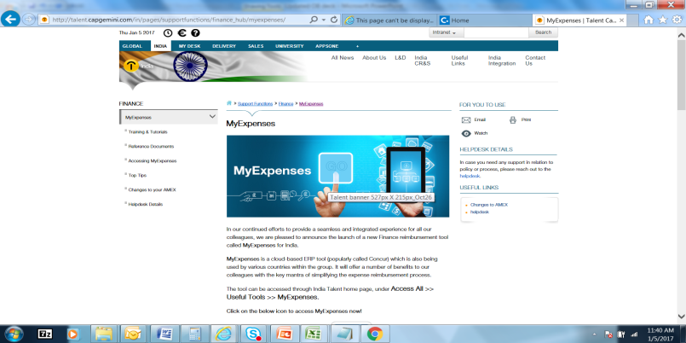
T&E: Expense System Overview
Systems & Tools
Capgemini Toolset
Time & Expense
System | Link | Expense Submission | Sources of Help
Expense Application | http://talent.capgemini.com/in/pages/supportfunctions/finance_hub/myexpenses | Method for submission Submit the soft copies for the claims in the tool | For technical issues, please raise ticket via FS SBU Service Desk portal (http://support.capgemini.com)
Notes:
Key Points:
Keep exercise within the time limit
Promote white board or flipchart use
Ensure everyone participates

Slide 28
T&E: Timesheet Entry Overview
Systems & Tools
Capgemini Toolset
Time & Expense
System | Link | Allocation | Approver
Clarity | https://clarity.fs.capgemini.com | All allocations are performed from INFORM & ISW applications Check the filter options if assigned project is not visible. Select “All” in the “Show tasks” dropdown and “All” in the “Task status” dropdown and then click on Filter button. Employee can enter time against two different projects allocated. | If timesheet does not appear in manager’s queue for approval, please raise a ticket via FS SBU Service Desk portal (http://support.capgemini.com) and mention who is your timesheet approver

Slide 29
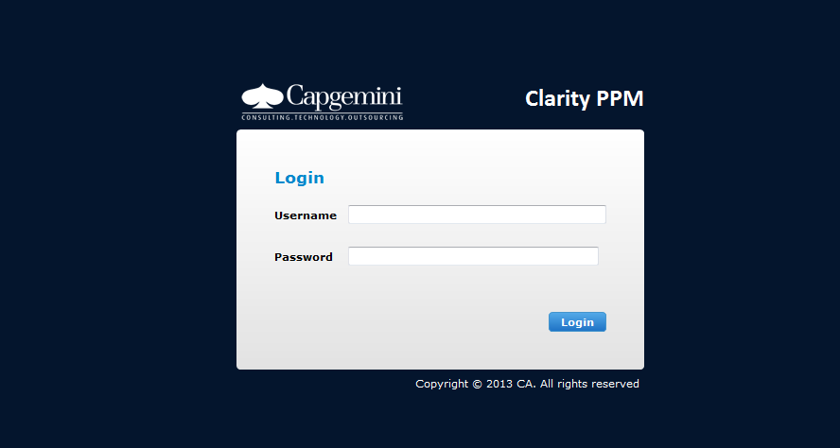
T&E: Timesheet Entry Exercise
Systems & Tools
Capgemini Toolset
Time & Expense
Objective: To submit your time into Clarity
Instructions
Log onto Clarity as follows:
Access the site: https://clarity.fs.capgemini.com
Login using your Capgemini User ID and Password
Click on Timesheets in the upper left-hand corner of the screen
Select the week you wish to enter time for
Click on Add Task
Select the Task Code for On-boarding and click Add
Enter 8 hours for today against the On-boarding task code
Click on Save
For any time entry /allocation related issues, please raise a ticket via the FS GBU Service Desk portal (http://support.capgemini.com)
***** DON’T FORGET *****
Clarity Timesheet Entry Process - Mandatory training for all new hires and Fresh joiners
All new hires and fresh joiners are required to attend below mandatory eLearning course on MyLearning Portal as soon as they get CORP id and password. Use below link to access the eLearning module.
Access Link: https://capgemini.sumtotalsystems.com/sumtotal/app/management/LMS_ActDetails.aspx?UserMode=0&ActivityId=302133
Notes:
Key Points:
Keep exercise within the time limit
Promote white board or flipchart use
Ensure everyone participates

Slide 30
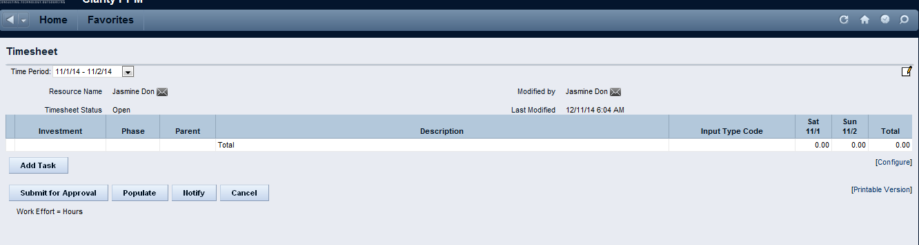
T&E: Timesheet Entry Exercise
Systems & Tools
Capgemini Toolset
Time & Expense
Time sheet: 9hrs/day. 45 hrs/wk
Click on Add Task Button
Notes:
Key Points:
Keep exercise within the time limit
Promote white board or flipchart use
Ensure everyone participates

Slide 31
T&A: Timesheet Approval Overview
Systems & Tools
Capgemini Toolset
Time & Expense
***** DON’T FORGET *****
Clarity Timesheet Approval Process - Mandatory training for all new hires with designation Senior Consultants and above
All new hires with designations Senior consultants and above are required to attend below mandatory eLearning course on MyLearning Portal as soon as they receive CORP id and password. Use below link to access the eLearning module.
Access Link: https://capgemini.sumtotalsystems.com/sumtotal/app/management/LMS_ActDetails.aspx?UserMode=0&ActivityId=302140

Slide 32

Compensation Structure – Bonus
Details
Annual performance bonus is a discretionary component and is subject to the prevailing Group and Company policies at the time of payout.
The bonus amount and the payout date is at the sole discretion of the Company and subject to change.
Employees who joined between Oct-Dec not eligible for bonus
Criteria and Eligibility
An employee is eligible for bonus if he/she is not serving notice period and is on Company’s rolls as of the payout date.
The bonus is based on individual and organization performance.

Slide 33
Career Path: Role Advancement
Systems & Tools
Resource Management
Career Path
Vice President
Senior Director
Director
Portfolio Manager
Senior Manager
Manager
Senior Consultant
Consultant
Associate Consultant
Notes:
Introduction:
As a new hire, you would typically join Capgemini as an AC or C, depending on your academic qualifications and professional background. After gaining sufficient experience and expertise, your career path could lead to becoming a Manager, later a Principal, and perhaps eventually a Vice-President.
Key Points:
The Associate Consultant position offers you an experience that spans across various industries, clients, and business issues. Learning is derived from intensive orientation programs to ongoing training and on-the-job apprenticeship.
Senior Consultants begin to develop specialized knowledge and manage a significant portion of project. They are encouraged to coach junior team members and serve as a thought partner to colleagues.
Managers build leadership skills by taking ownership of engagements while learning to keep one eye on the big picture and the other on the details.
Vice-Presidents define the culture and identity of Capgemini, as well as helping to manage the company. They are intellectual leaders, bringing innovative business and strategic thinking to the company and its clients.

Slide 34
Business Cards
Systems & Tools
Getting Started
Business Cards
Objective: To order your business cards
Instructions
Visit https://iconnect.fs.capgemini.com and log into the site
Please log in using your user ID and password
Choose Browse Facilities → Business Card Applications – For India only
Enter Project Code , Task Code , Job title and Mobile Number
Click Submit
You will receive a Confirmation ID number
ICRES Team will process your Business Card request and will issue in 7 working days
Notes:
Key Points:
Keep exercise within the time limit
Ensure everyone participates
Show them your card
Share card with clients and colleagues

Slide 35
Company Transportation
Systems & Tools
Getting Started
Transportation
Company Transport
The Company provides employees with transportation services to and fro from Capgemini FS SBU
This policy is applicable for all employees of Capgemini
To utilize the transportation services in Pune/Hyderabad, employees must possess a bus pass
Apply for bus pass via iConnect (Facilities>Bus pass) and collect from ICRES representative
Charges:
ICRES contact: Bhimrao Kamble +91 9922995640

Slide 36
Company Transportation
Responsibilities and Duties for New Joinees availing Company Transport Facility
New Joinees are allowed for first 3 days of joining free transport services subject to prior authorization from Transport team
Transport team will look at the seat availability and advise the associate whether to travel or not in the buses
Any employee found travelling without a bus pass or an authorization will be penalized as per the policy
Please reach to the pickup point 5 min prior to scheduled pick up time
Bus will not wait at any pick-up point beyond the scheduled pick up time
Please coordinate with route coordinator for any help or assistance
Employees should not try to influence/force the driver to divert the bus from the pre-designated routes. In case of violation, the employeee will be liable for disciplinary action

Slide 37
Knowledge Management (KM)
Systems & Tools
Capgemini Toolset
Knowledge Management
The KM 3.0 Global Community is designed to help you navigate for global content
It is structured along industries or sectors, service lines or offerings, software or products, enabling functions, and certification communities
http://km3.capgemini.com
Web link: https://km3.capgemini.com/financial-services/home
Employee Handbook- https://km3.capgemini.com/book/585257
Notes:
Key Points:
Most of all collateral is here
Make sure you check “ search all KM community”
Some files are protected with owners who need to give permission
Conclusion:
Share your work here

Slide 38
Referral Bonus Program
Systems & Tools
Capgemini Toolset
RMG
Note: Please read FS SBU Referral Bonus Policy
Eligibility | Contact
For each referral that gets hired as a full-time employee, you are eligible for a bonus after the candidate completes their first 90 days Note: You must be employed by FS SBU at the time of the bonus payout | Recruitment team/ Conversion Team

Slide 39
FS SBU People Care
People Care

Slide 40
FS SBU People Care Organization
People Care
Learning & Development
People Care Organization
Learning and Development
People Processes
Technical competence
Industry knowledge building
Leadership capability development
E-learning
Learning infrastructure
Compensation and benefits
Performance management
Career development
Employee relations and communication
Employee information systems

Slide 41
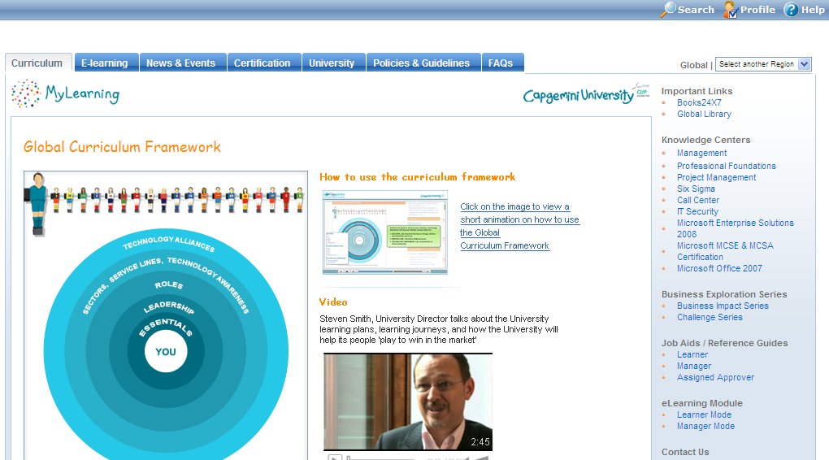
MyLearning: Learning on Demand
People Care
Learning & Development
MyLearning
MyLearning gives you access to a wealth of learning to enhance your professional development (classroom training, on-line training, etc.)
MyLearning allows you to create a clear training plan, to view, manage & track your learning activities online (http://mylearning.capgemini.com)
MyLearning is accessible to anybody within the Group, from anywhere, at anytime via the web

Slide 42
Benefits Overview
People Care
Benefits / Compensation
Salary A/c – CITI Bank/HDFC Bank/ICICI Bank/IDBI Bank (Features - Zero Balance)
Payroll – Salary Processing : Please update your Account No. at iConnect> My Information > Personal Information>Bank Account No/ & PAN Card details. This is an one time activity.
Please update your PAN details on https://ess.excelityglobal.com after processing of the first salary, else there would tax deduction reflecting in the second salary
Corporate Credit Card – American Express (Amex Card)
POC- Richa Kulshreshtha
For all official travel expenses only
Global Grade | ACIS | BSv | FS
F | VP | VP | VP
E | Associate Director and Director (M5, M6) | Director (O10) | Director and Senior Director

Slide 43
Benefits Overview
People Care
Benefits / Compensation
Provident Fund (PF)
SPOC –Sonal Daundkar
Helpdesk: cgretiralsservices@excelityglobal.com
PF Transfer
Normal waiting period – 90 days
Necessary forms
Nomination & Declaration form
PF Transfer form
Info required
Name of the trust/ Company Name
Account No.
Filled up Form 13 (Revised)
Form 3A

Slide 44
Benefits Overview
People Care
Benefits / Compensation
Gratuity
For continuous service of 5 years or more at the time of separation
No contribution by employees
Gratuity nomination form to be filled during Onboarding
Wedding Gift Policy
All employees who get married after joining Capgemini are eligible for a wedding gift worth Rs.2000
The wedding application is available on iConnect. Fill in details and submit your wedding invitation or marriage certificate.
The gift is valid for 2 months from the date of your marriage
Process will take 15 days to one month from the date of submission. Your wedding gift will reflect in the next months payroll.

Slide 45



Benefits Overview
People Care
Benefits / Compensation
Providing an environment of wellness and care for employees is a priority at the FS GBU
Insurance cover for employee and family members for medical and other emergencies
MyHealth@Capgemini program for overall wellbeing
Other Allowance and Reimbursements (OAAR) for financial wellbeing
Insurance Policies
Group Term Life Policy
Hospitalization Insurance Policy
Group Accident Policy
Group Dependent Parent Policy
MyHealth@Capgemini
Onsite Health Screening Program
Online Health Risk Assessment
Doctor On Call
Healthy Pregnancy Program
Employee Assistance Program
Financial Wellbeing-OAAR
Medical
Telephone
Leave Travel Allowance
Meal Voucher
Vehicle & Driver Reimbursement
National Pension Scheme

Slide 46
Benefits Overview
People Care
Benefits / Compensation
Medical Insurance
Cashless Benefit
Maternity Benefit
New Born Baby Insurance
Pre & Post Hospitalization covered (30 days prior and 60 days post)
Pre existing Condition Benefit
AON Global is our Insurance Broker
United Health Care (UHC) is our TPA (Third Party Administrator)
United Healthcare Website: www.uhcpindia.com
E Medical Card
AON contact details: Rajesh Dhore:7506932880 / Pritam Sonawane :8888855868
Capgemini Coordinator: Sampat Tidke Contact No: Extn. 2015767
Employee Age Limit | Sum Insured (INR)
Age 18 years to 30 years | 200,000
Age 31 years to 40 years | 300,000
Age 41 and above | 400,000

Slide 47
Benefits Overview
People Care
Benefits / Compensation
Parents Medical Insurance –
Members Covered – Employees have the option of covering Parents / Parent-in-laws
Pre Enrolment Medical Check up – Not Required
Sum Insured – Option of INR 1 Lac / 2Lac / 3 Lac / 4 Lac /5 Lac per Parent/Parent-in-law
Cashless Benefit
Pre & Post Hospitalization covered (30 days prior and 60 days post)
Premium Rate Card-
20% co-pay will be applicable for each claim.
One year waiting period for specified diseases - waived off
Medical Tests are not required for enrollment
Only persons up to the age of 80 years can be covered under the policy.
Employees interested to enroll their parents/parent-in-laws can connect immediately with
Rajesh Dhore:7506932880, email capgemini.pune@globalinsurance.co.in.
Please go through the Employee Handbook on KM3.0 for further details on all Benefits

Slide 48
Benefits Overview
Benefits / Compensation
People Care
Benefits / Compensation
Age Band | INR 100,000 | INR 200,000 | INR 300,000 | INR 400,000 | INR 500,000
36 – 40 Years | 8,547 | 17,094 | 19,231 | 21,369 | 23,505
41 – 45 Years | 10,138 | 20,278 | 22,813 | 25,349 | 27,881
46 – 55 Years | 11,986 | 23,978 | 26,973 | 29,970 | 32,967
56 – 65 Years | 15,849 | 31,699 | 35,662 | 39,624 | 43,587
66 – 70 Years | 16,847 | 33,697 | 37,911 | 42,122 | 46,334
71 – 75 Years | 17,989 | 35,976 | 40,473 | 44,970 | 49,467
76 – 80 Years | 18,902 | 37,802 | 42,528 | 47,252 | 51,980

Slide 49

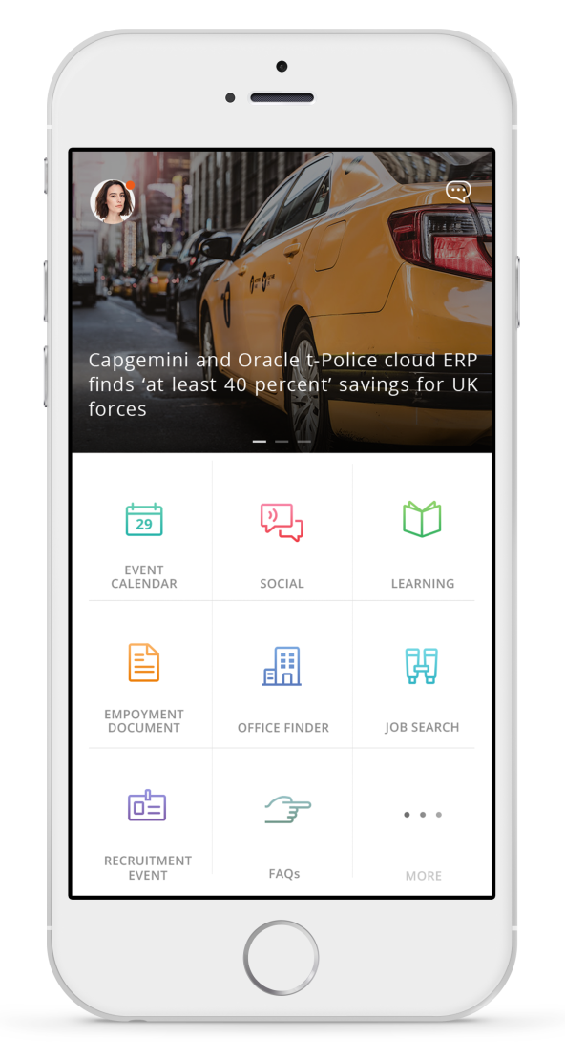
HR Genie App
For the HR Professional
For the Employee
Learning
Chat
Learning
Chat
Ability to schedule training globally
Automate the feedback cycle
View global dashboard of learning's
Manage global facilitator community
Collect real time customer data
Channelize all transactional requests to one service desk
Create more engagement through data
Register for Courses
View Learning Calendar/Catalog
Suggests learning to associate based of career framework role
Provide feed back
Connect to our service desk
Operating hours 9:00am-530pm IST
1000 commonly asked questions trained and more to be added
News & Notifications
Employment Documents
News & Notifications
Employment Documents
Create and publish region/city/account specific news stories
Send push notifications to all employees or just a single user
Collect data on what types of documents are being requested
Allows for a level of governance that doesn’t exist with current tools
Talent page on your phone
Save articles
Keep your notifications organized
Push out news stories to specific regions/SBU’s
Automates digital stamping function
Easy access to employees in ODC’s
24 hour turn around
FAQ’s
FAQ’s
Gain insights on if our employees understand our policies
Eliminate the need for human interaction for transactional requests
2000 commonly asked questions
HR team can directly add/delete new question/answers

Slide 50
HR Genie App
For the HR Professional
For the Employee
Event Calendar
Social
Event Calendar
Social
Allows us to communicate all HR activities to a global, local audience
Manage create, approve, and remove events
Allows us to cascade media (pics and videos) of HR activities
Control over user’s media content
Promote specific events, people, teams, priorities in a fun way
Employees can comment and engage in activities they are interested in
Push notifications enabled
Streamlined way to view all activities
Allows employees to share accomplishments
Allows employees to see what their colleagues are up to around the world
View media global or by location
Like and comment on posts
Survey/Mood Meter*
Job Search
Survey/Mood Meter*
Job Search
Facilitate polling surveys
Get feedback results real-time
Gather data on common feelings of employees and the reason behind them
Allows easier participation to polling surveys
Provide timely feedback
Plot feelings and describe why you have them
Share feelings with colleagues
Allows employees to view the latest job opportunities in Capgemini
Job opportunities can be filtered by keywords and location
Upload CV’s
Maintain and update job opportunities currently available
Collect data on commonly searched jobs

Slide 51
Health & Safety Policy
People Care
Benefits / Compensation
Capgemini is committed to the protection of the health ,safety and well being of all the members and hence strives to promote strong and sustainable culture of a safe and healthy workplace that will facilitate the awareness of the risk and prevention of the injury and illness.
Capgemini will always try and implement the best practices and work towards the continuous improvement of it’s health and safety policies
All employees are responsible for complying with all applicable health and safety requirements, policies and procedures

Slide 52
Health & Safety Policy
People Care
Benefits / Compensation
Responsibilities of employees
Wear helmets while riding two wheelers and seat belts while driving four wheelers
Always adhere to the traffic rules and regulations and practice safe driving
Follow the procedure to report any emergency to the respective stakeholders
Contact the Emergency Response Team for Security personnel for immediate assistance

Slide 53
Leaves
People Care
Benefits / Compensation
Sick Leave / Holiday / Vacation
Categories of leave:
Privilege leave
Compassionate leave
Maternity leave
Paternity leave
Leave for Adoption
Leave without Pay
Compensatory leave (at the discretion of the supervisor)

Slide 54
Leaves
People Care
Benefits / Compensation
Sick Leave / Holiday / Vacation
Privilege leave
Permanent employees are eligible to take 22 working days as privilege leave (prorata basis) in a calendar year. Privilege leave
includes casual and sick leave.
Privilege Leave would be credited on first day of month. For month of January to May and July to November, 2 days of leave
would be credited and for month of June and December 1 day of leave would be credited
A maximum of 15 days of unutilized leave can be carried forward to the following year each calendar year.
You can accumulate a maximum of 30 days of privilege leave. Any leave in excess of 30 days lapses
Leave has to be planned at the beginning of the year
In the event of cessation of employment, privilege leave is encashed upto a maximum of 30 days.
Minimum 5 days leaves required to claim LTA
Compassionate leave
5 days leave granted in the event of a death in the immediate family
If the employee is at the client site during such an event, the company will bear the travel expenses
Maternity leave
Eligible women employees entitled to maximum of 26 weeks of maternity leave. All intervening holidays and
weekends falling during period of maternity leave are counted.
In the event of a miscarriage, employee entitled to 45 days leave with pay from that day
Paternity leave
5 working days at the time of the birth of the child

Slide 55
Leaves
People Care
Benefits / Compensation
Sick Leave / Holiday / Vacation
Public holidays - 10 in a year
Employees at the client site or on projects working as per client calendar, shall follow the client list of holidays
Leave for Adoption
Women employees can avail leave up to:
2 calendar months for adopting infant (less than one year old)
Up to 1 calendar month for adopting a child (more than one year old)
Eligible male employees are entitled to a maximum of 5 working days of Paternity/Adoption leave
Leave without Pay
Any leave applied for in excess of the existing leave balance
It will be approved on case to case basis

Slide 56
Holidays
People Care
Benefits / Compensation
Sick Leave / Holiday / Vacation
For the 2017 calendar year, 10 holidays are observed by Capgemini FS SBU
On these holidays, the Capgemini offices will be closed
For Holiday list, log on to: https://iconnect.fs.capgemini.com/frmHolidays.aspx
Note: Holiday list is city specific

Slide 57
Professional Dress Code for Women
Being a Capgemini Consultant
Consulting Guard
ATTIRE | BUSINESS CASUALS (MONDAY - THURSDAY) | SMART CASUALS (FRIDAY) | NOT OFFICEWEAR
INDIAN | Salwar Kameez, Churidar, Kurta, Sari | Business Casuals
TROUSERS | Formal Trousers, Gaberdines, khakis | Business Casuals, Jeans | Big Checks, Capri, Bermudas, Shiny Trousers, Hipsters, Suspenders.
SKIRTS | Long/ Short Skirts with plain / faint Stripes | Business Casuals, Knitwear/ Floral Skirts, Denim | Mini Skirts, Wrap-around, Shiny Party wear, three-fourths
SHIRTS | Shirt- Full Sleeves, Half Sleeves, T-Shirt-Collared only | Business Casuals, Checks/Stripes, Shirt with ( Sleeveless Jacket), big Floral Prints, T-Shirt Collared only | Lycra
TOPS | Plain, Lace | Business Casuals, Plain Satins, Small Floral Prints, Big Floral Prints/ Sleeveless | Lycra, Tank tops, Figure Hugs without jacket, Spaghetti.
FOOTWEAR | Slip- Ons, leather / Suede Boots/ Shoes, Leather / Suede Sandals | Business Casuals, Court shoes, Rubber Sport, Keds, velvet Boots, Canvas Shoes, Suede | Slippers, Sports Sandals, Floaters.
*Please also cover-up any tattoos
Notes:
Key Points:
Facilitator needs to be prepared for questions
Generally, conservative is always more appropriate

Slide 58
Professional Dress Code for Men
Being a Capgemini Consultant
Consulting Guard
ATTIRE | BUSINESS CASUALS ( MONDAY -THURSDAY) | SMART CASUALS (FRIDAY) | NOT OFFICEWEAR
TROUSERS | Formal Trousers, Gaberdines, khakis | Same as Business Casuals, Jeans | Cargos, Cowboy Pants, Big Checks Pants, three Fourths, Excersize pants, Sweat pants
SHIRT | Shirt-Full Sleeves, Half Sleeves, T-Shirt Collared only ( Should be tucked in) | Same as Business Casuals ( should be Tucked in) T-Shirt Collared only | Sleeveless, t-shirt with slogans( except Capgemini) Pictures, Collarless T-Shirts
FOOTWEAR | Leather, Suede | Business Casuals, Sports Shoes, Canvas Shoes | Slippers/ Chappals, Sandals, Floaters, Open Shoes
*Please also cover-up any tattoos
Notes:
Key Points:
Ask if anyone is wearing white socks (joke)
With clients always start formal (suit/tie) and then more casual if appropriate in the environment
Wrinkle free shirts are good
Avoid baggy clothing (shouldn’t be able to fit a second person in your shirt)

Slide 59
Relocation for India Joinees
People Care
Benefits / Compensation
Payroll
Relocation Expenses
Relocation expenses will include below mentioned expenses and will be reimbursed on production of
actual receipts.
Transportation of household goods
Cost Incurred on packing and moving (P&M) of personal goods and effects (excluding vehicle) arranged
through any vendor will be reimbursed subject to the submission of the following:
Original payment receipt on the vendor's letter head/bill mentioning the vendor's PAN No and Service Tax No.
This should be duly attested by vendor.
Original list of items transported and signed by the candidate and acknowledged by the vendor. This should also
mention the starting location and destination.
Original Insurance premium receipt (if claimed)
Original Octroi receipts across locations
Original Good Receipt Note /Delivery Challan on the Vendor Letter head – countersigned by the candidate.
Notes
Capgemini will not be held liable for any loss or damage or delay in delivery of goods during transit.
The reimbursement of P&M of personal goods and effects is non-taxable
Original receipts would be required for Reimbursement
In case the employee resigns before 1 year, the relocation claim must be returned as part of final
settlement.

Slide 60
Useful Intranet Weblinks (Office Network or VPN Access Only)
iConnect: http://iconnect.fs.capgemini.com
Delivery
Clarity: https://clarity.fs.capgemini.com
INFORM: https://inform.fs.capgemini.com
Knowledge Management Portal (KM 3.0): http://km3.capgemini.com
Webmail: https://webmail.in.capgemini.com
Facilities
Bus Pass: https://buspass.fs.capgemini.com
Business Cards: http://capgeminifs.cgconverge.com
My Capgemini Brand Store: capgemini.companystore.in
Finance
Expense: http://talent.capgemini.com/in/pages/supportfunctions/finance_hub/myexpenses/
Contribution to WeKare: http://wekare.in.capgemini.com/contribute
Employee Management:
My Path: https://myconnect.capgemini.com
Leave Management System: https://lms.fs.capgemini.com
Learning Portal: http://lnc.fs.capgemini.com
Internal Job Posting (IJP): http://ijp.fs.capgemini.com
Resource Management Group: https://orts.fs.capgemini.com/RMGHome.aspx

Slide 61
Payroll
Being a Capgemini Consultant
Consulting Guard
Please use the below links for payroll e learning's and FAQ’s
https://km3.capgemini.com/book/354978
For further information please contact the payroll team at
Inpayroll.fssbu@capgemini.com
Notes:
Key Points:
Ask if anyone is wearing white socks (joke)
With clients always start formal (suit/tie) and then more casual if appropriate in the environment
Wrinkle free shirts are good
Avoid baggy clothing (shouldn’t be able to fit a second person in your shirt)

Slide 62
Useful Intranet Weblinks (Office Network or VPN Access Only)
Global Talent: http://talent.capgemini.com
India Talent: http://talent.capgemini.com/in
FS Talent: http://talent.capgemini.com/global/pages/hubs/strategic_business_units/financial_services/
Ethics & Compliance: http://talent.capgemini.com/ethicsandcompliance
Blue Book: http://talent.capgemini.com/global/pages/about_us/our_group/ethicsandcompliance/Blue_Book
My Essentials Curriculum:
http://talent.capgemini.com/university/pages/curriculum/essentials_curriculum
India Employee Handbook: https://km3.capgemini.com/book/585257
WeKare: http://wekare.in.capgemini.com

